Slide 1
بسم الله الرحمن الرحیم

Slide 2
ARTHROSCOPIC ROTATOR CUFF REPAIR
Mohsen Mardani-Kivi, M.D.
Associate Professor
Guilan University Of Medical Sciences

Slide 3
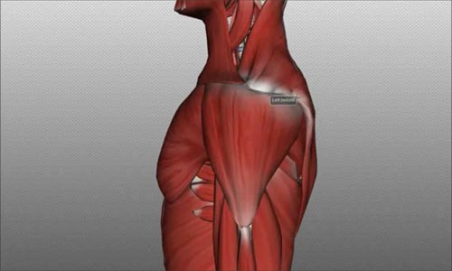

Slide 5
RCT: a complex etiology
Lesions of the rotator cuff represent a complex etiology due to various factors such as:
muscular-tendinous degeneration,
osteo-articular alterations,
micro and macro trauma,
functional overloading.

Slide 6
RCT: a complex etiology
The most common cause of a rotator cuff tear is degeneration.
Many degenerative tears are very small and should be avoided from surgery.
Take home message: Proposing a surgery should only occur after failed conservative treatment.

Slide 7
Just because something is torn does not mean it needs to be fixed!

Slide 8
Treat the subject… not the MRI finding!
All people are not created equal! All tears are not created equal!
When determining what the proper treatment option is, consider:
the type of tear,
Past history,
Goals of the treatment,
Current quality of life
Physical ex.
AND your MRI findings.

Slide 11
Traumatic tears are mostly treated differently than degenerative ones.
a normal tendon + a traumatic event = RCT.
Take home message: in traumatic cases do not wait too long. It is better to treat these sooner rather than later.

Slide 12
Is it self-limited?!
Whatever the etiological moment may be, it is very rare that a tendinous lesion of the cuff heals spontaneously.

Slide 13
important element
fatty muscular degeneration: a criterion that can guide the physician in assessing the age of the lesion and its repair potential.

Slide 14
TREATMENT OPTIONS

Slide 15
Conservative treatment
Conservative treatment (requiring valid PT support) is in general reserved for:
massive cuff lesions with substantial tendinous retraction and muscular degeneration, with the head in upward migration and reduction of the acromio-humeral space.

Slide 16
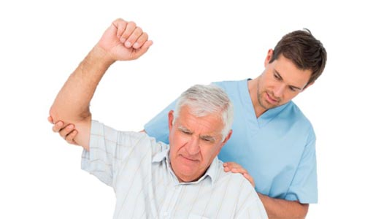
Conservative treatment
First of all, clearly indicate the clinical picture to the patient and explain exactly what he can expect from treatment.
Second, choose the surgery for the Patient! not for the M.R.I!

Slide 17
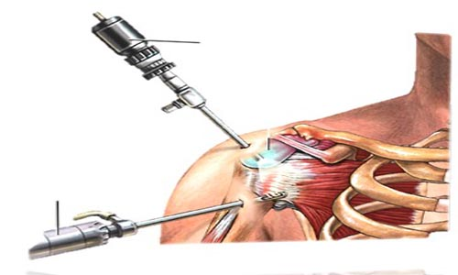
TREATMENT OPTIONS
ASAD/debridement without repair
Open repair
Mini-open repair
Arthroscopic repair

Slide 18
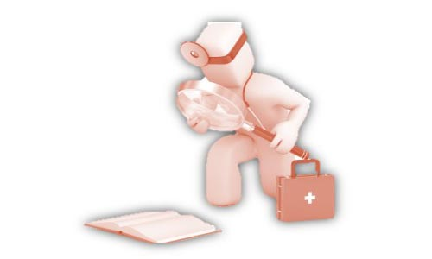
TREATMENT PRINCIPLES
Address associated pathology
Adequate decompression
Assess tear-size, retraction, pattern, tissue quality, repairability
Tendon mobilization
Secure repair
Supervised rehabilitation program

Slide 19
SURGICAL INDICATIONS
Pain
Functional deficits
Failure to respond to nonoperative care
Full-thickness tear
Extensive partial-thickness tear
Acute injury

Slide 20
ADVANTAGES OF ARCR
See both sides of cuff
Visualize all pathology-labral tears, biceps, OA, etc.
Easier releases(esp. capsule)
Less pain, morbidity
Smaller scars
Better ROM
PATIENTS WANT IT!

Slide 21
DISADVANTAGES OF ARCR
Learning curve
Smaller contact area with bone for healing
High retear rate by ultrasound reported
Pain from resorption of anchors
Coding/reimbursement problems

Slide 22
TECHNIQUE FOR ARCR
1- Define tear
2- Mobilize tendons
3- Prepare tuberosity
4- Cuff reduction
5- Place anchors
6- Suture management
7- Pass sutures through tear edge
8- Knot tying

Slide 23
1- DEFINE TEAR
View from anterior and from posterior
Measure with probe known size
Trim ragged edges but preserve tissue

Slide 24
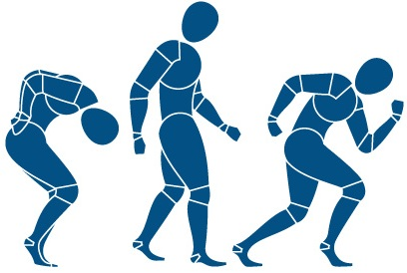
2- MOBILIZE TENDONS
Place retention sutures
Release capsule
Anterior interval release
Posterior interval release

Slide 25
3- PREPARE TUBEROSITY
Remove excrescences but preserve cortex
Trim tendon stump
Define footprint

Slide 26
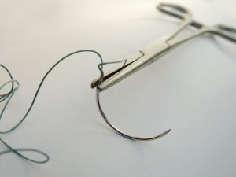
4- MARGIN CONVERGENCE
Begin cuff reduction
Work medial to lateral
Side to side sutures
Tie knots

Slide 27
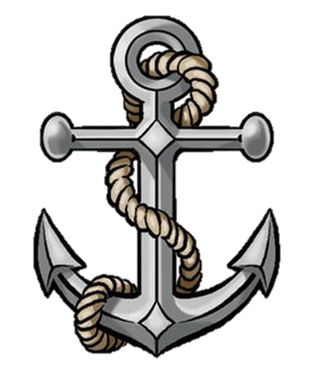
5- PLACE ANCHORS
At lateral aspect of footprint
Metal or biodegradable
Make sure well fixed in bone

Slide 28
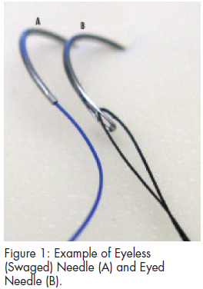
6- SUTURE MANAGEMENT
Keep track of portals
Avoid tangles
Think one step ahead
Move at steady pace

Slide 29
7- PASS SUTURES THROUGH TEAR EDGE
Many devices available
Avoid tearing tendon
Line up puncture with anchor

Slide 30
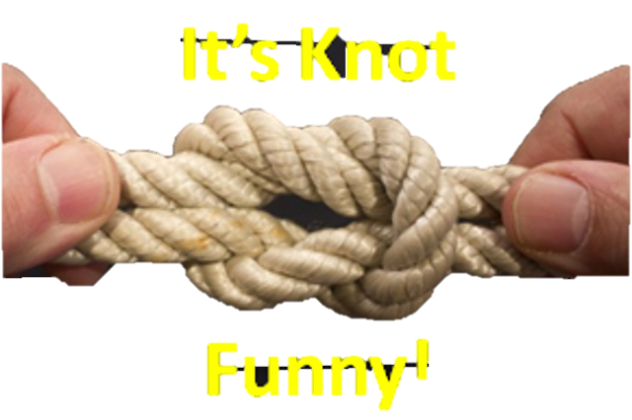
8- KNOT TYING
Perfect knots
Perfect knots
Flawlessly perfect knots

Slide 31
Errors in technical performance:
poor repair of the trans-deltoid approach,
excessive acromial resection,
insufficient mobility of the tendons to be sutured,
neurological lesions (axillary or suprascapular nerve).

Slide 32
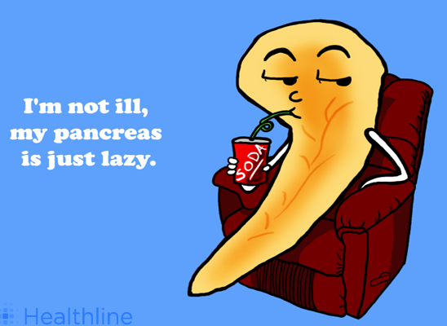
Challenges
What makes successful repair more difficult?
Smoking
Diabetes
cortone Injections

Slide 33
Challenges
What makes successful repair more difficult?
Large/Massive rotator cuff tears
88-95% improvement
Recurrent tears

Slide 34
Any questions?

