Slide 1
In the name of God

Slide 2
Surgical Approaches for Calcaneal fracture
Mohsen Mardani-Kivi, M.D.
Associate Prof. Orthopedic Department, Guilan University Of Medical Sciences

Slide 3
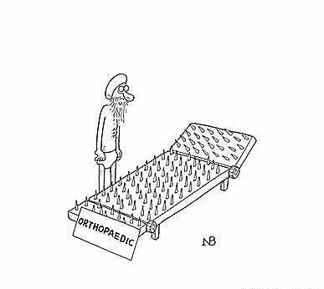
feel the same?!?!

Slide 4

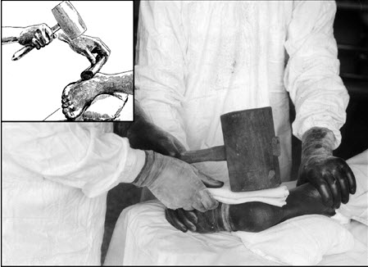
Notes:
Closed reduction using a hammer!!!

Slide 5
Case 1
Age/Gender/CC: | 50/M/ Pain, swelling and inability to walk
History of Present Illness: | Road traffic accident 1 wk back.
Notes:
Case C1894 - limited open reduction and internal fixation of joint depression variety of # calcaneum using sinus tarsi approach

Slide 6
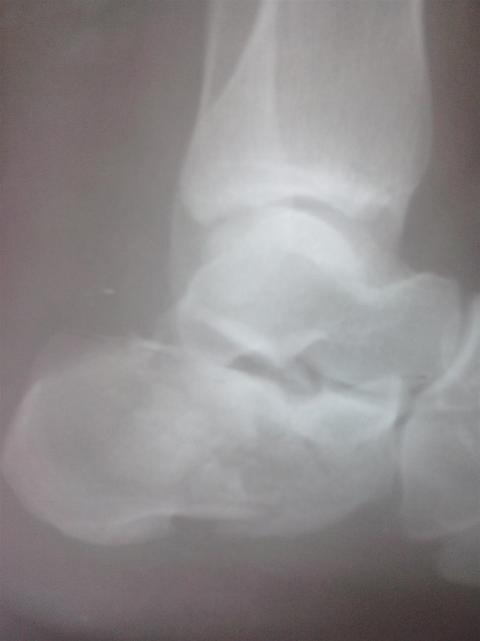
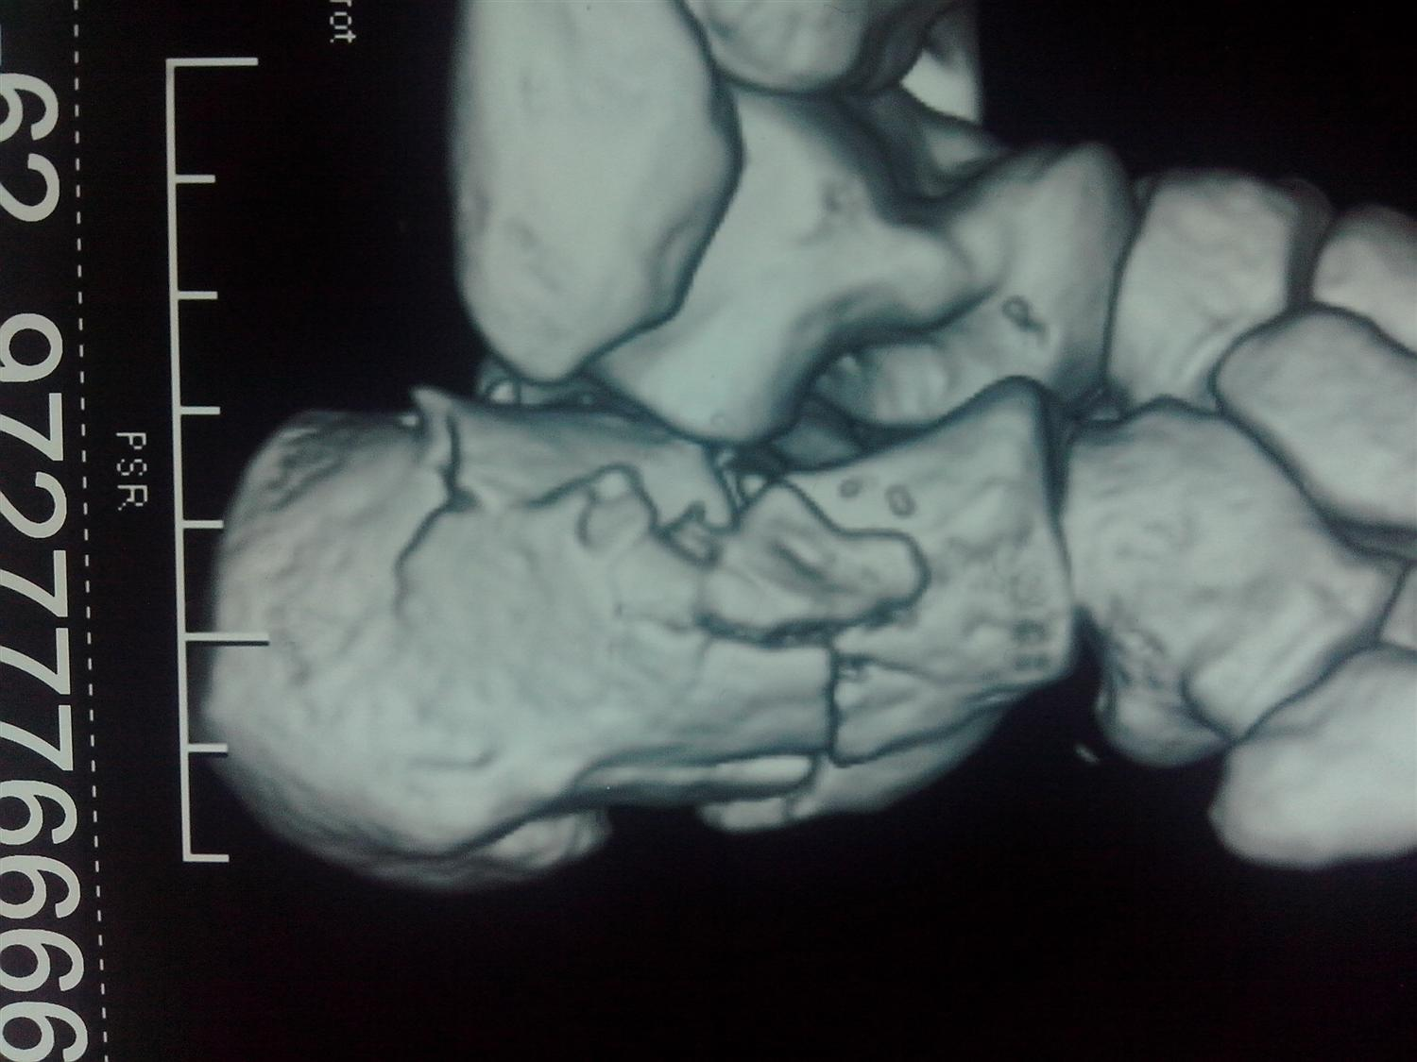
Case 1

Slide 7
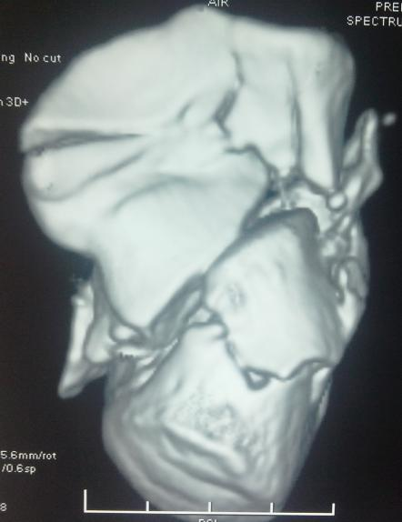
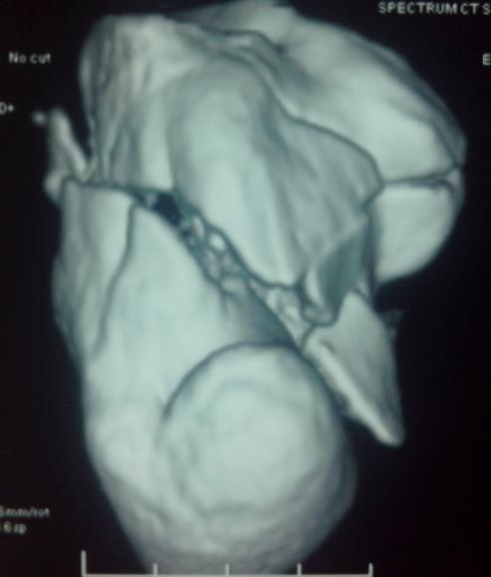
Case 1

Slide 8
valuable comment pls !
9%
Cast
Open reduction by extensile lateral approach
16%
Closed k wiring and cast
45%
Limited open reduction by sinus tarsi approach and screw fixation
29%
Notes:
Procedure 1:
under spinal anesthesia , lateral position, under TQ control, sinus tarsi incision marked in italic S shape, from tip of lateral malleolus to calcaneocuboid joint, depressed lateral half of posterior facet elevated with curved elevator, fixed with 4 mm cc screw, tuberosity manipulated with elevator inserted within # site and with schanz screw in tuberosity, percutaneous fully threaded 4 mm cc screw inserted to fix tuberosity with anterior process and to buttress posterior facet.

Slide 9
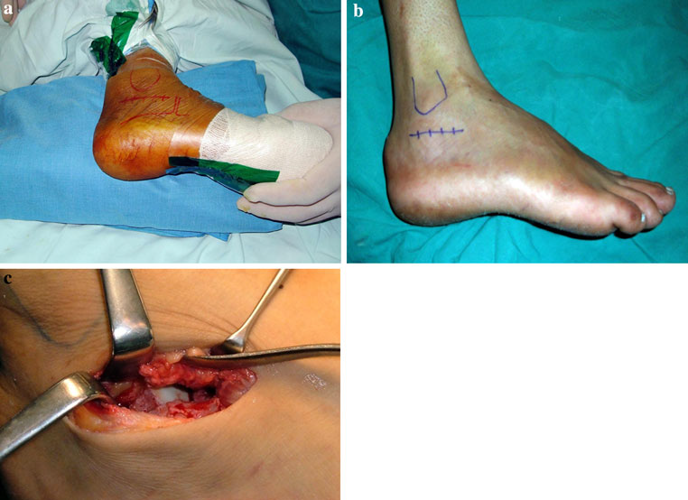

Slide 10
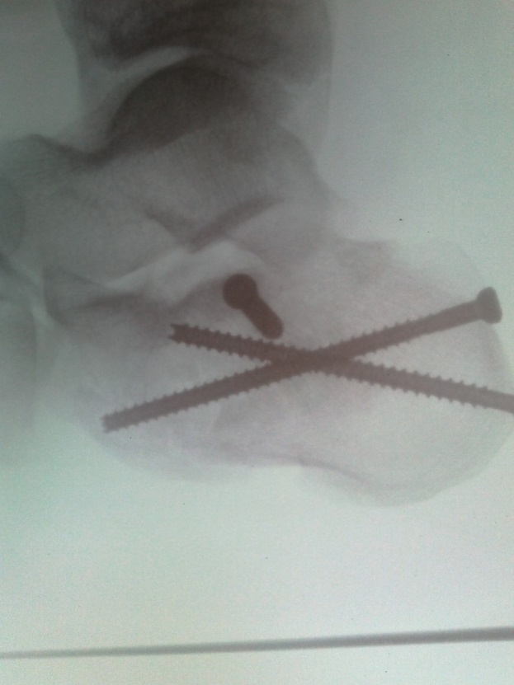
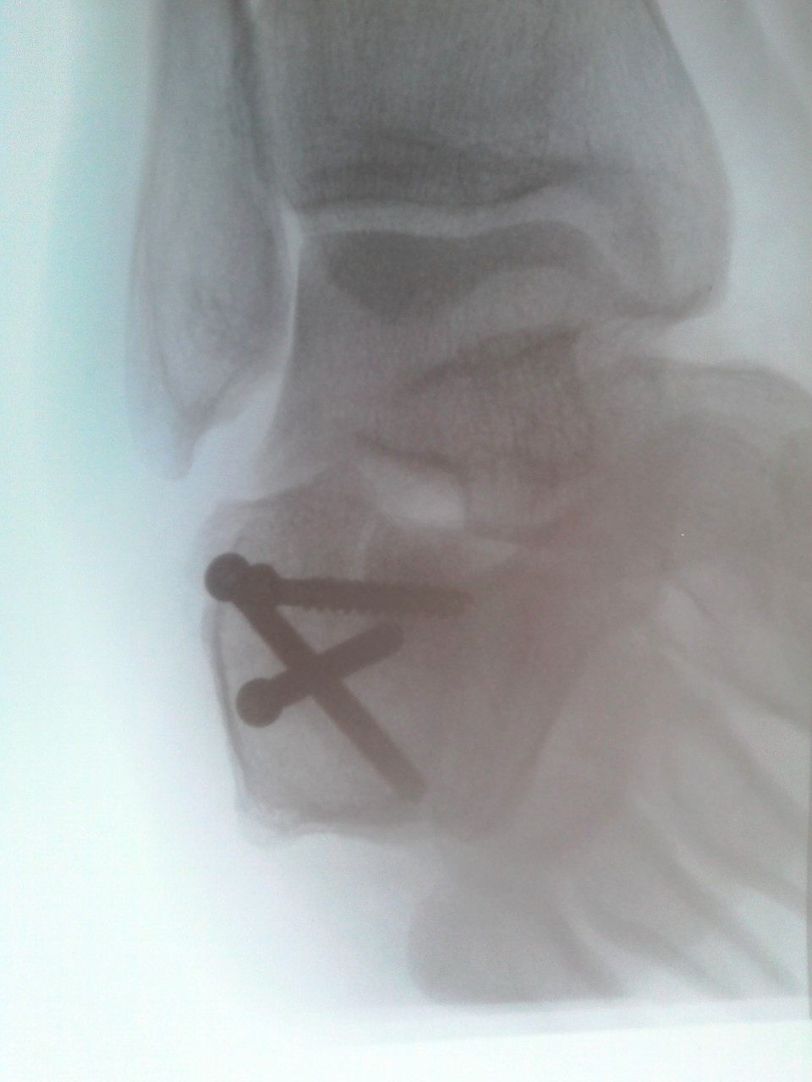

Slide 11

Ready for Another Question?!

Slide 12

Case 2
Age/Gender/CC: | 41/M/ fall from height unable to stand after
History of Present Illness: | fall from height bilateral calcaneus fracture (bilateral calcaneal fracture, but discussion for left)
Notes:
Case C1597 - left calcaneal fracture

Slide 13
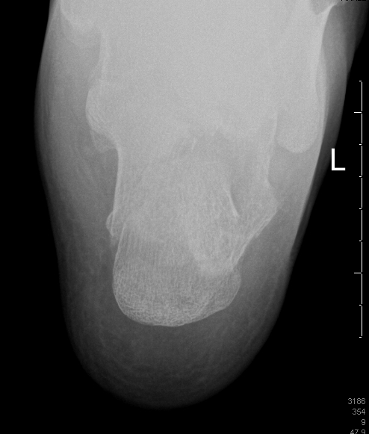
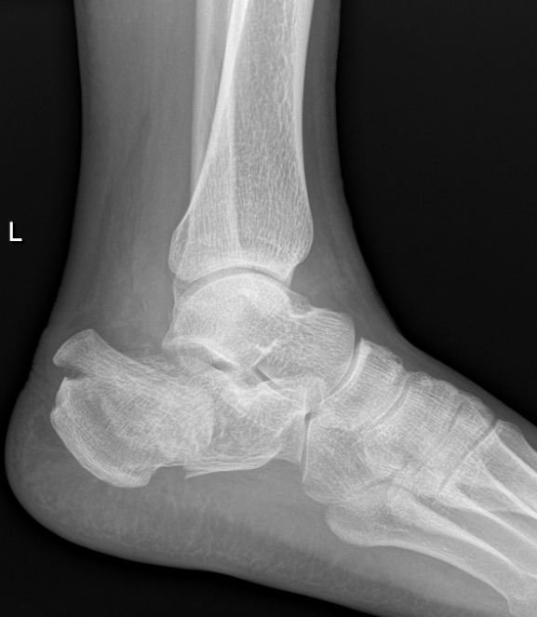
Case 3

Slide 14
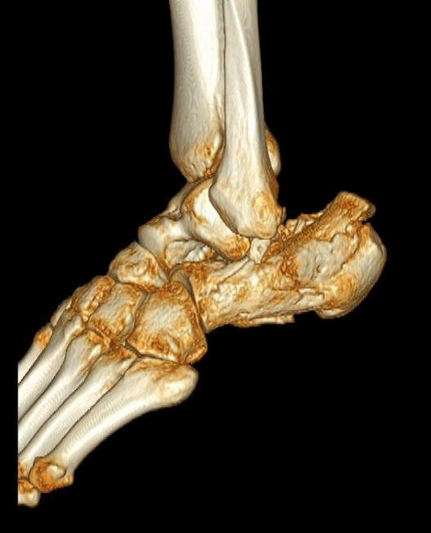
Case 3

Slide 15
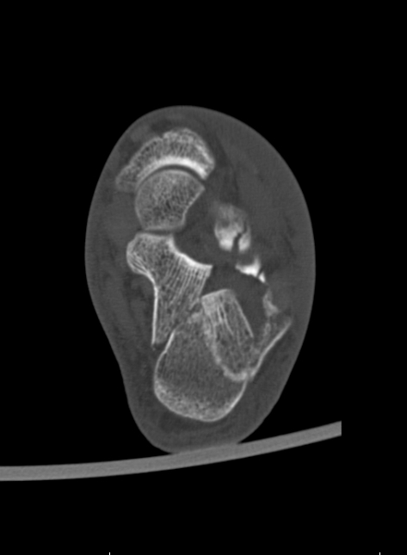
Case 3

Slide 16
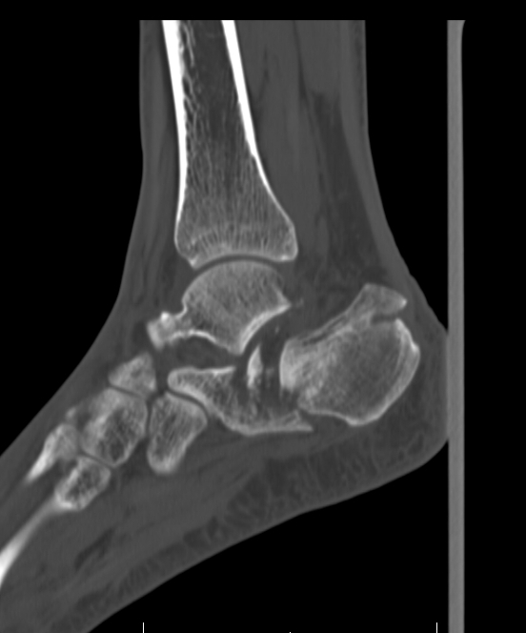
Case 3

Slide 17
Your preferred method?
Percutaneous reduction and fixation
7%
ORIF through a mini-open
75%
ORIF through an extensile lateral approach
13%
Acute fixation and fusion of subtalar joint
3%

Slide 18
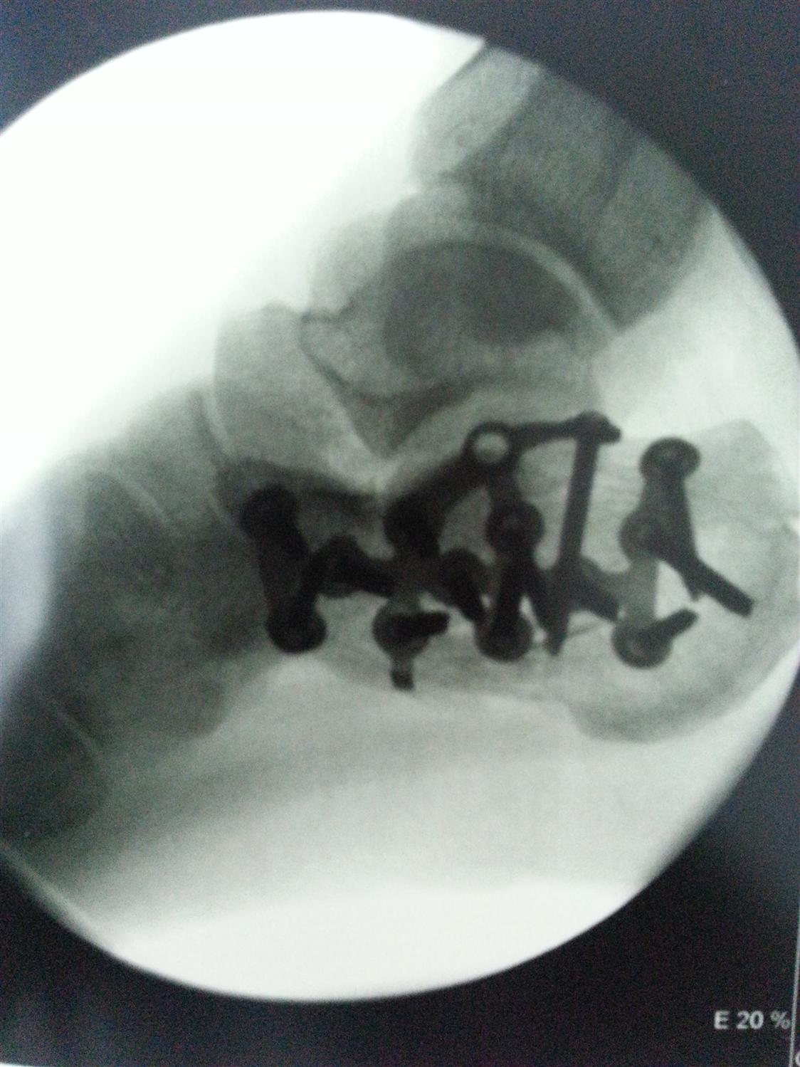
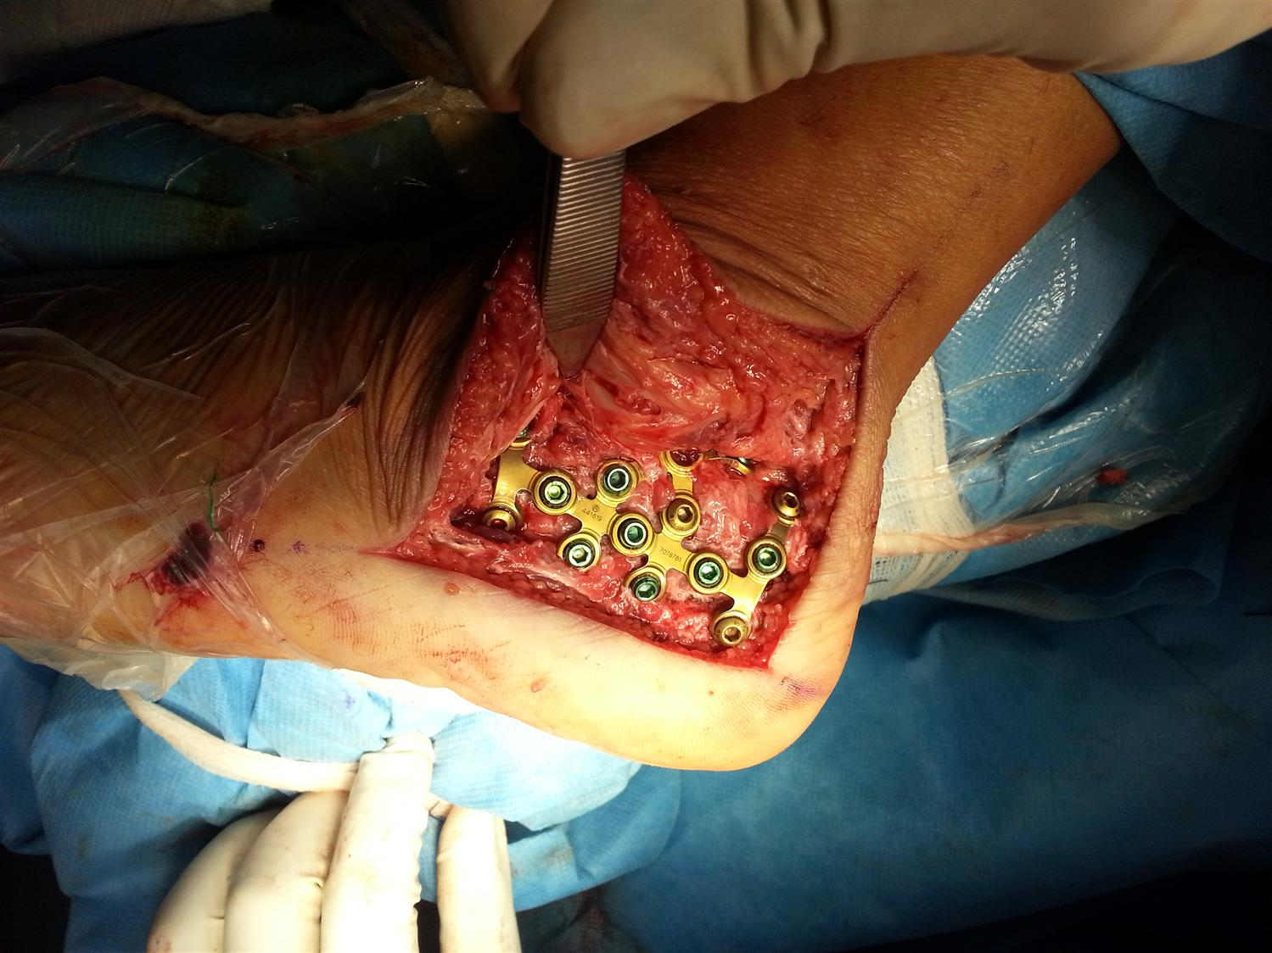
Case 3

Slide 19
Approaches

Slide 20

Extensile Lateral Approach
Introduction
  Allows visualization of the lateral calcaneus and subtalar joint

Slide 21

Position & Preparation
Preparation
  radiolucent table
  C-arm fluoroscopy
  tourniquet can be used
Position
  lateral decubitus positioning is necessary
  slightly flex knee to relax gastrocnemius muscle pull

Slide 22
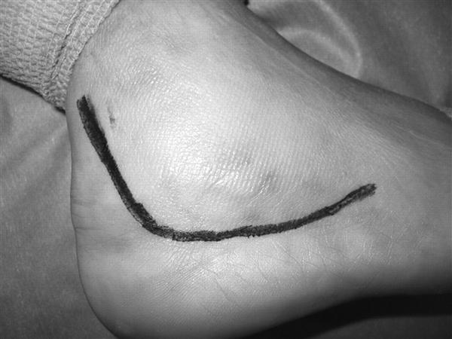
Lateral Approach
Incision:
  extensile L-shaped incision is made
Notes:
extensile L-shaped incision is made
vertical limb starts 2 cm proximal to tip of fibula, at anterior edge of Achilles tendon
vertical limb is curved anteriorly at inferior edge to meet horizontal limb
horizontal limb starts posteriorly at end of vertical limb just above glabrous skin
at the anterior aspect, the incision is curved dorsally to allow access to the calcaneocuboid joint

Slide 23
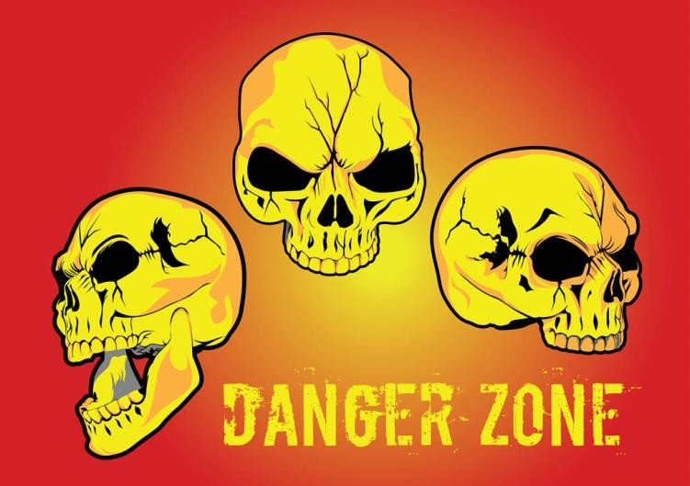
Dangers
Peroneal tendons
Risk is minimized with maintenance of access under the anterior flap
must evaluate upon closure for instability or laceration(s)
Notes:
Peroneal tendons
risk is minimized with maintenance of access under the anterior flap
must evaluate upon closure for instability or laceration(s)
Sural nerve
risk is minimized with maintenance of access under the anterior flap
must dissect out proximal aspect of vertical limb and anterior aspect of horizontal limb to minimize iatrogenic injury
Wound dehiscence
most common complication of this approach
lateral calcaneal artery is responsible for corner of flap
careful attention to skin handling and closure with Allgower-Donati suture technique minimizes soft tissue complications

Slide 24

Dangers
Sural nerve
Risk is minimized with maintenance of access under the anterior flap
must dissect out proximal aspect of vertical limb and anterior aspect of horizontal limb to minimize iatrogenic injury

Slide 25
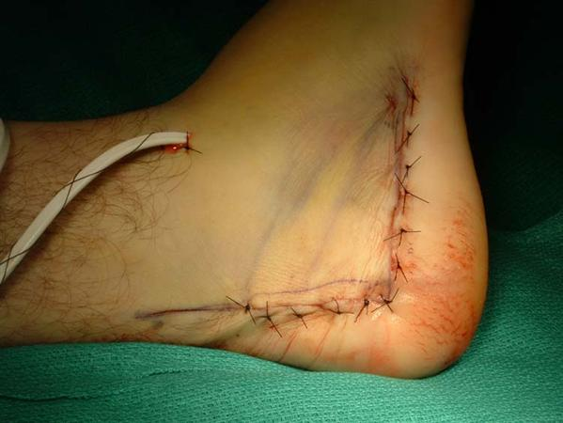
Dangers
Wound dehiscence
The most common complication
lateral calcaneal artery is responsible for corner of flap
careful attention to skin handling and closure with Allgower-Donati suture technique minimizes soft tissue complications

Slide 26

Medial Approach
Incision
  Begin 2.5 anterior and 4cm distal to medial malleolus
  Incise along medial surface of foot to tendo calcaneus

Slide 27
Medial Approach
Deep Dissection
Divide fat and fascia to define the inferior margin of abductor hallucis
Mobilize abductor hallucis and retract dorsally to expose medial surface of calcaneal body
Subperiostally strip muscle and plantar aponeurosis off medial and inferior calcaneus

Slide 28

Dangers
Medial calcaneal nerve
Nerve to abductor digiti minimi

